Slide 1


Slide 2
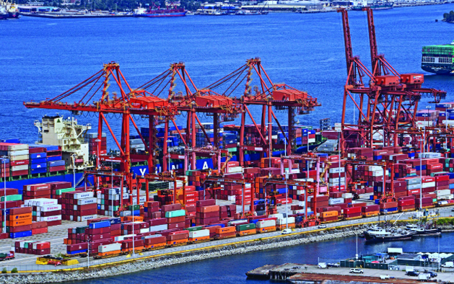
15
INTERNATIONAL TRADE POLICY
Notes:
Notes and teaching tips: 4, 5, 6, 23, 29, 44, 45, 48, 51, and 52.
To view a full-screen figure during a class, click the expand button.
To return to the previous slide, click the shrink button.
To advance to the next slide, click anywhere on the full screen figure.
Applying the principles of economics to interpret and understand the news is a major goal of the principles course. You can encourage your students in this activity by using the two features: Economics in the News and Economics in Action.
(1) Before each class, scan the news and select two or three headlines that are relevant to your session today. There is always something that works. Read the headline and ask for comments, interpretation, discussion. Pose questions arising from it that motivate today’s class. At the end of the class, return to the questions and answer them with the tools you’ve been explaining.
(2) Once or twice a semester, set an assignment, for credit, with the following instructions:
(a) Find a news article about an economic topic that you find interesting.
(b) Make a short bullet-list summary of the article.
(c) Write and illustrate with appropriate graphs an economic analysis of the key points in the article.
Use the Economics in the News features in your textbook as models.

Slide 3
After studying this chapter, you will be able to:
Explain how markets work with international trade
Identify the gains from international trade and its winners and losers
Explain the effects of international trade barriers
Explain and evaluate arguments used to justify restricting international trade
Copyright © 2019 Pearson Canada Inc.

Slide 4
How Global Markets Work
Because we trade with people in other countries, the goods and services that we can buy and consume are not limited by what we can produce.
Imports are the good and services that we buy from people in other countries.
Exports are the goods and services we sell to people in other countries.
Notes:
The key facts are worth emphasizing: enormous growth in volume of trade and huge two way trade in manufactures.
Explain that the balance of trade along with the international borrowing and lending that finances it results from spending and saving decisions in Canada and the rest of the world and is independent of the forces that generate the volume of trade, which this chapter covers.

Slide 5
How Global Markets Work
International Trade Today
Global trade today is enormous.
In 2016, global exports and imports were $21 trillion, which is a third of the value of global production.
In 2016, total Canadian exports were $629 billion, which is about 31 percent of the value of Canadian production.
In 2016, total Canadian imports were $677 billion, which is about 33 percent of the value of Canadian production.
Services are 17 percent of total Canadian exports and 19 percent of total Canadian imports.
Notes:
Classroom activity
Check out Economics in Action: We Trade Metals for Consumer Goods

Slide 6
How Global Markets Work
What Drives International Trade?
The fundamental force that generates trade between nations is comparative advantage.
The basis for comparative trade is divergent opportunity costs between countries.
National comparative advantage as the ability of a nation to perform an activity or produce a good or service at a lower opportunity cost than any other nation.
Notes:
Note that comparative advantage and its basis is explained in Chapter 2. Remind the students and send them back to that chapter for a quick review.
There is an enormously rich heritage of stories, parables, fables, and satires that you can use to enliven your classes on this topic. The following fable, inspired by James Ingram, International Economic Problems, John Wiley, 1970, is powerful way to begin. Make up your own version with local flavor and embellishment.
Adam Blackbox announces that he has discovered an amazing way to produce low-price, high-quality automobiles. He sets up a plant on a large tract of land along the coast of Massachusetts, hires 10,000 employees, swears them to secrecy, and begins delivering his low-price, high-quality autos to the nation’s showrooms. Adam Blackbox is hailed as an American industrial hero. Blackbox Enterprises floats stock and Wall Street booms.
Consumers love Adam Blackbox. His automobiles are better and cheaper than those they could buy before he came along. Automakers hate him, but their attempts to pass laws to restrict his operations fail. The president and congressional leaders explain that economic adjustment is an inevitable consequence of technological advance. And Adam Blackbox’s new technology for delivering low-price, high-quality automobiles is clearly part of the process of achieving greater prosperity for all.
(continued on slide 48)
You can easily segue from this story to the analysis of Canada and China.

Slide 7
How Global Markets Work
The opportunity cost of producing a T-shirt is lower in China than in Canada, so China has a comparative advantage in producing T-shirts.
The opportunity cost of producing a regional jet is lower in Canada than in China, so Canada has a comparative advantage in producing regional jets.
Both countries can reap gains from trade by specializing in the production of the good at which they have a comparative advantage and then trading.
Both countries are better off.

Slide 8
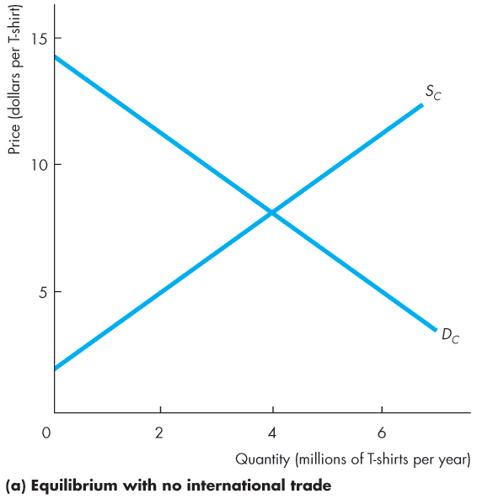
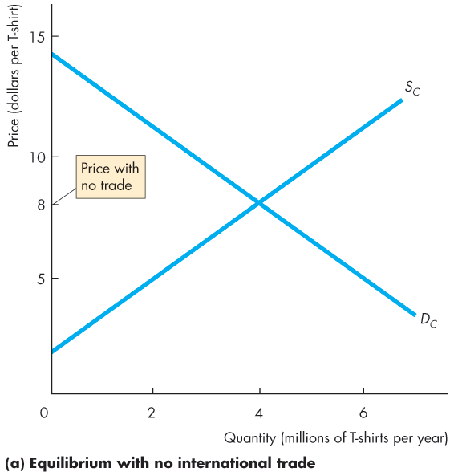
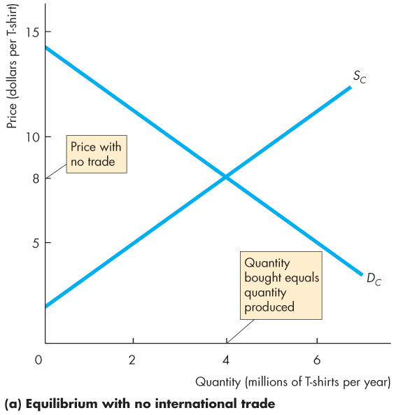
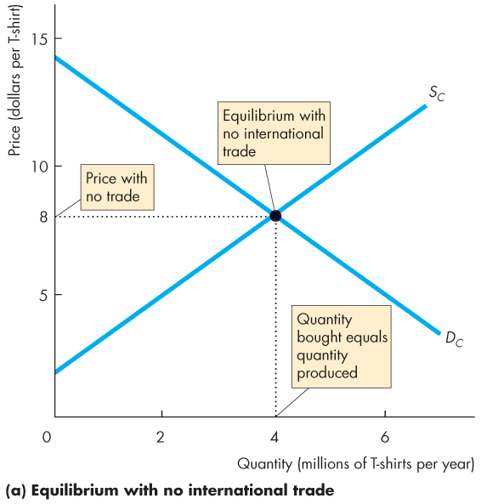

How Global Markets Work
Why Canada Imports T-Shirts
Figure 15.1(a) shows Canadian demand and Canadian supply with no international trade.
The price of a T-shirt at $8.
Canadian firms produce 4 million T-shirts a year and Canadians buy 4 million T-shirts a year.

Slide 10
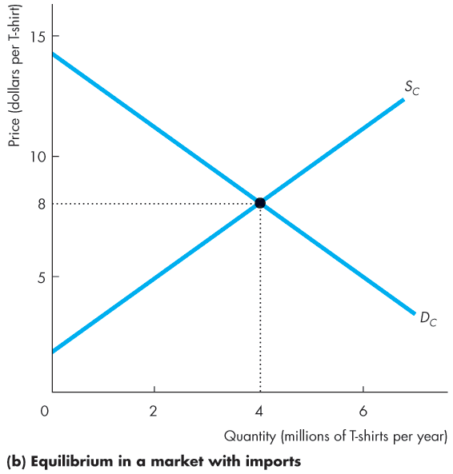
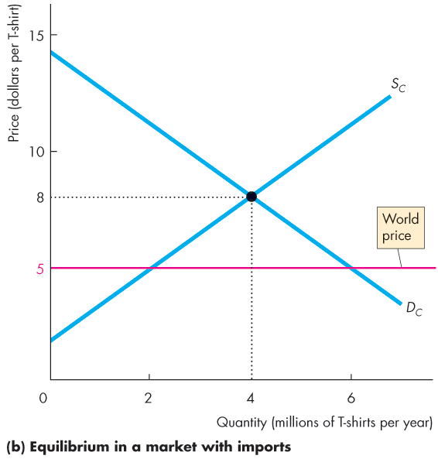
How Global Markets Work
Figure 15.1(b) shows the market in Canada with international trade.
World demand and world supply of T-shirts determine the world price of a T-shirt at $5.
The world price is less than $8, so the rest of the world has a comparative advantage in producing T-shirts.

Slide 11
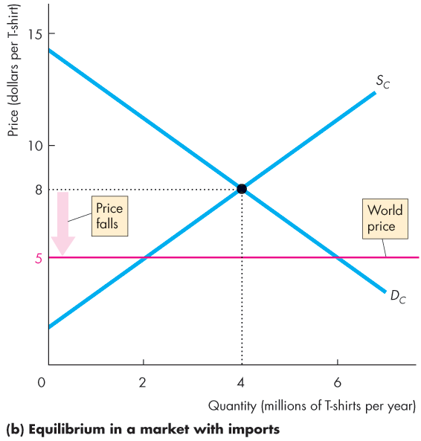
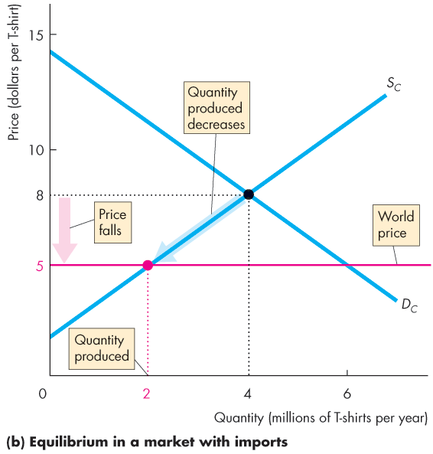
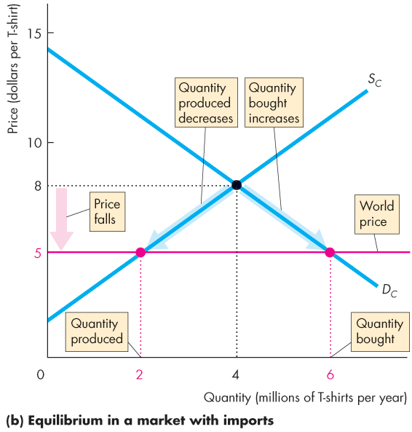
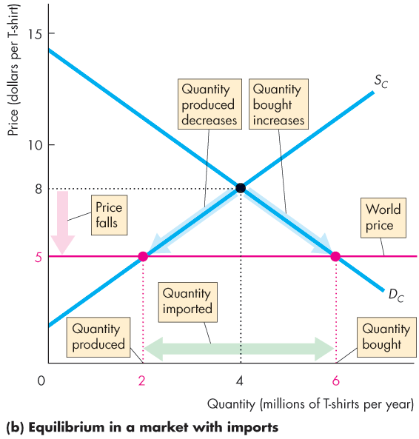

Slide 12
How Global Markets Work
With international trade, the price of a T-shirt in Canada falls to $5.
At $5 a T-shirt, Canadian garment makers produce 2 million T-shirts a year.
At $5 a T-shirt, Canadians buy 6 million T-shirts a year.
Canada imports 4 million T-shirts a year.

Slide 13
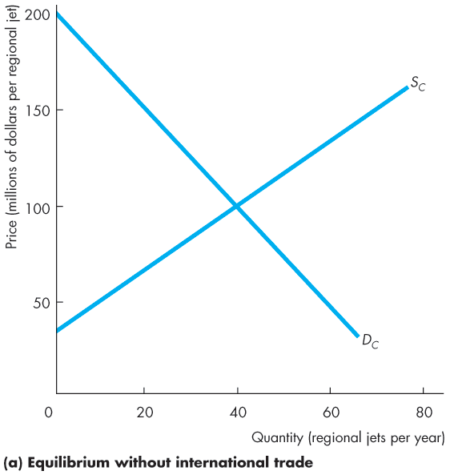
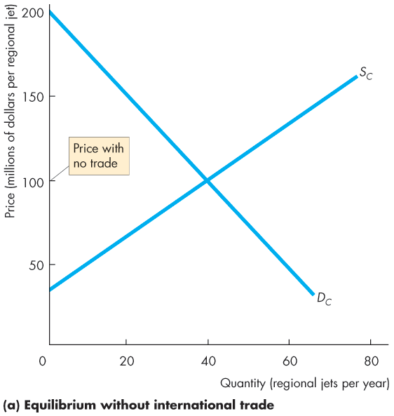
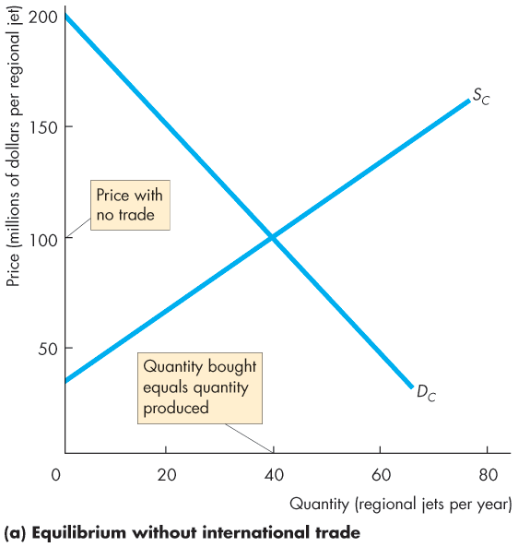
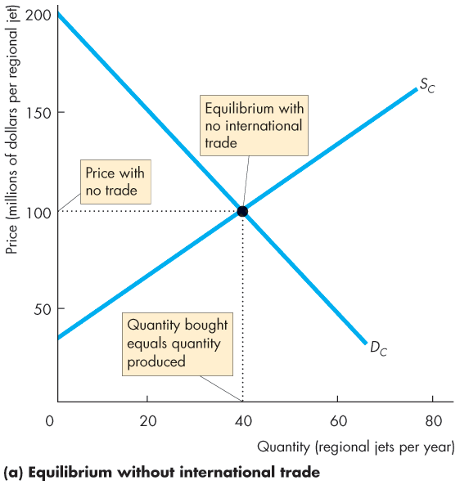
How Global Markets Work
Why Canada Exports Regional Jets
Figure 15.2(a) shows Canadian demand and Canadian supply with no international trade.
The price of a jet at $100 million.
Bombardier produces 40 regional jets a year and Canadian airlines buy 40 a year.

Slide 15
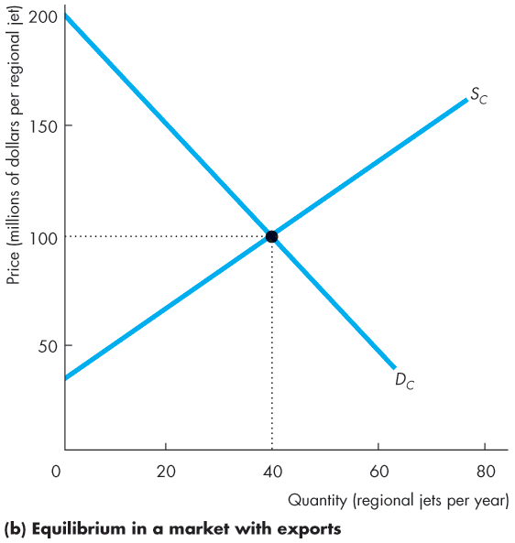
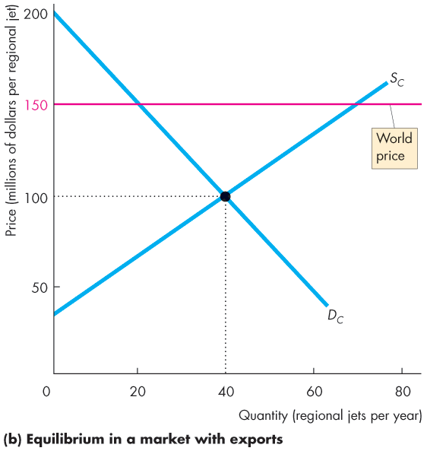
How Global Markets Work
Figure 15.2(b) shows the market in Canada with international trade.
World demand and world supply of jets determine the world price of a regional jet at $150 million.
The world price exceeds $100 million, so Canada has a comparative advantage in producing regional jets.

Slide 16
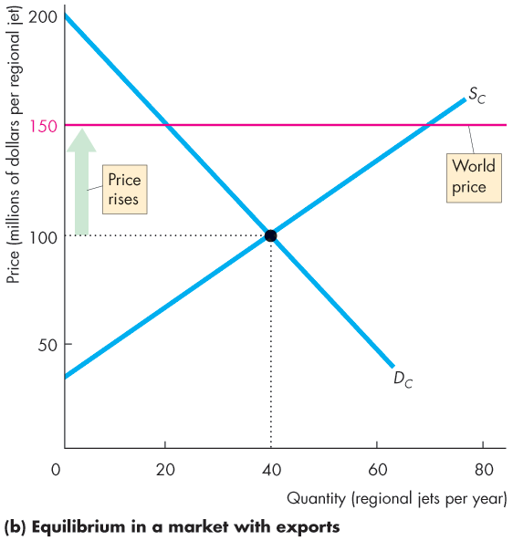
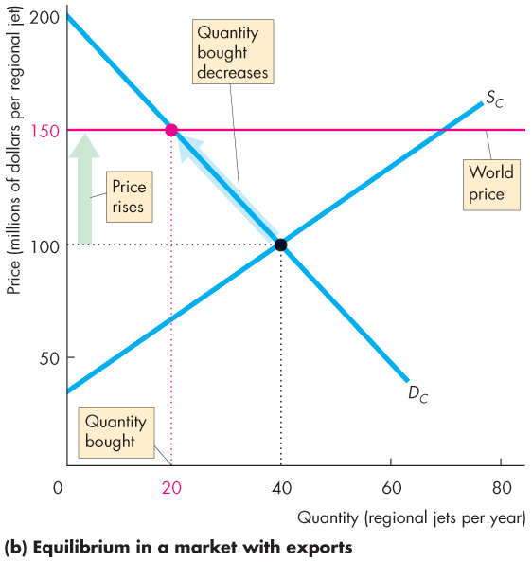
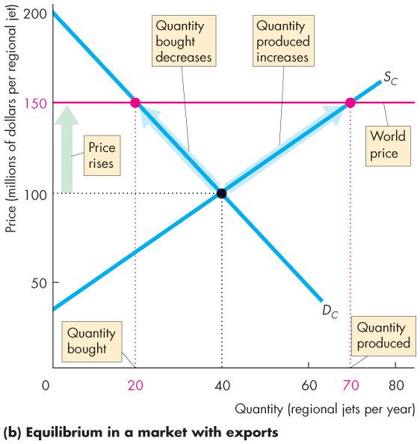
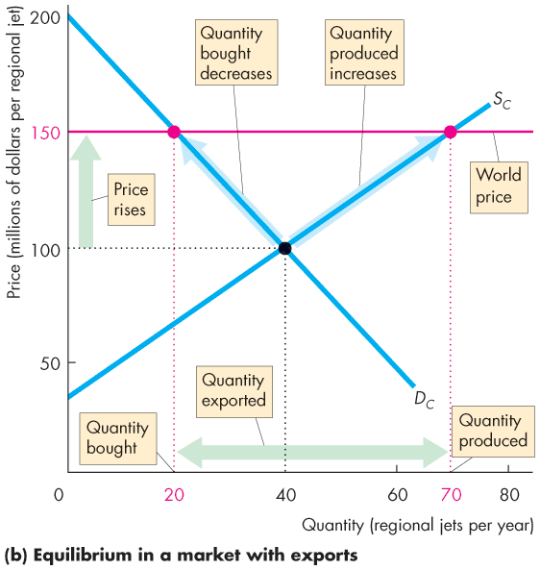

Slide 17
How Global Markets Work
With international trade, the price of a jet in Canada rises to $150 million.
At $150 million, Canadian airlines buy 20 jets a year.
At $150 million, Bombardier produces 70 regional jets a year.
Canada exports 50 regional jets a year.

Slide 18
Winners, Losers, and the Net Gain from Trade
International trade lowers the price of an imported good and raises the price of an exported good.
Buyers of imported goods benefit from lower prices and sellers of exported goods benefit from higher prices.
But some people complain about international competition: not everyone gains.
Who wins and who loses from free international trade?

Slide 19
Winners, Losers, and the Net Gain from Trade
Gains and Losses from Imports
We can measure the gains and losses from imports by looking at the effects on
The prices paid and quantity bought by domestic consumers
The price receives and the quantity sold by domestic producers
Consumers gain from imports: Buyers pay a lower price and buy more of the good.
Domestic producers lose from imports: Domestic producers receive a lower price and sell a smaller quantity.

Slide 20
Winners, Losers, and the Net Gain from Trade
Gains and Losses from Exports
We can measure the gains and losses from exports by looking at the effects on
The prices paid and quantity bought by domestic consumers
The price receives and the quantity sold by domestic producers
Domestic consumers lose from exports: Consumers pay a higher price and buy less of the good exported.
Domestic producers gain from exports: Producers receive a higher price and sell a more of the good exported.

Slide 21
How Global Markets Work
Gains for All
Domestic producers of the exported good and domestic consumers of the imported good gain
Domestic producers of the imported good and domestic consumers of the exported good lose
The gains exceed the losses:
Producers of the exported good gain what consumers lose and gain more from the higher price on the items exported.
Consumers of the imported good gain what the domestic producers lose and gain more from the lower price on the items imported.

Slide 22
International Trade Restrictions
Governments restrict international trade to protect domestic producers from competition.
Governments use four sets of tools:
Tariffs
Import quotas
Other import barriers
Export subsidies

Slide 23
International Trade Restrictions
Tariffs
A tariff is a tax on a good that is imposed by the importing country when an imported good crosses its international boundary.
For example, the government of India imposes a 100 percent tariff on wine imported from Canada.
So when an Indian wine merchant imports a $10 bottle of Ontario wine, he pays the Indian government $10 import duty.
Notes:
The formal analysis in this section is straightforward. You might want to draw parallels between tariffs and taxes.
Classroom activity
Check out Economics in Action: Canadian Tariffs Almost Gone
Check out Economics in the News: The U.S.-Canada Lumber Dispute

Slide 24
International Trade Restrictions
The Effects of a Tariff
With free international trade, the world price of a T-shirt is $5 and Canada imports 4 million T-shirts a year.
Imagine that Canada imposes a tariff of $2 on each T-shirt imported.
The price of a T-shirt in Canada rises by $2.
Figure 15.5 shows the effect of the tariff on the market for T-shirts in Canada.

Slide 25
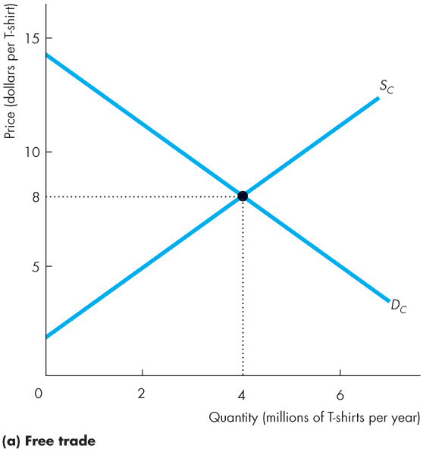
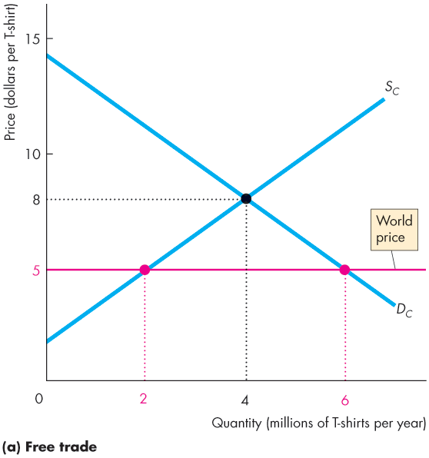
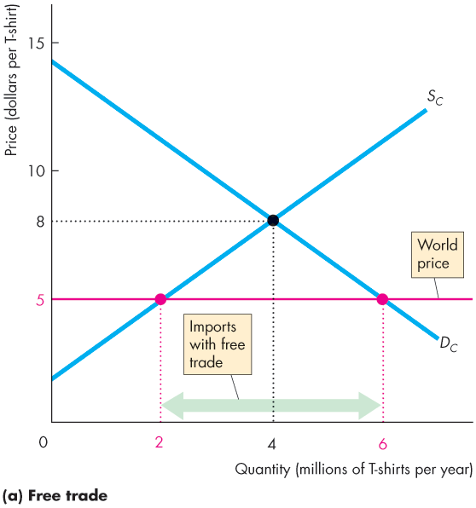
International Trade Restrictions
Figure 15.3(a) shows the market before the government imposes the tariff.
The world price of a T-shirt is $5.
With free international trade, Canada imports 4 million T-shirts a year.

Slide 27
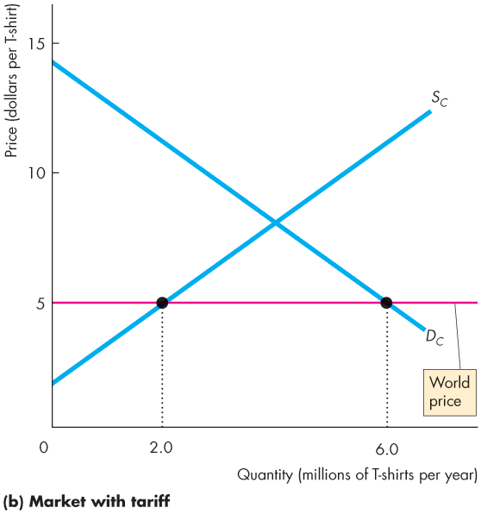
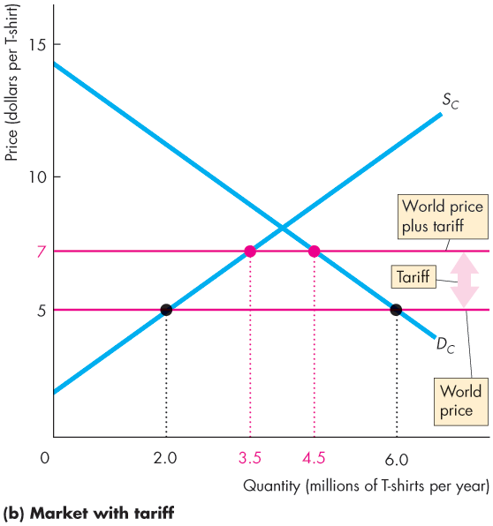
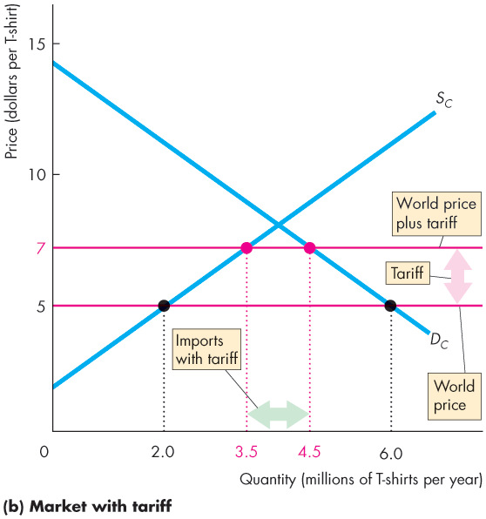
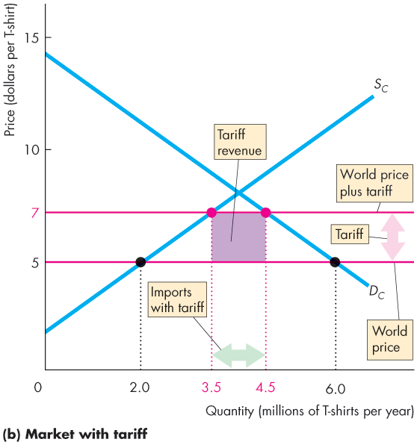
International Trade Restrictions
Figure 7.5(b) shows the effect of a tariff on imports.
The tariff of $2 raises the price in Canada to $7.
Canadian imports decrease to 1 million a year.
Canadian government collects the tax revenue of $2 million a year.

Slide 29
International Trade Restrictions
Winners, Losers, and Social Loss from a Tariff
When the Canadian government imposes a tariff on imported T-shirts:
Canadian consumers of T-shirts lose.
Canadian producers of T-shirts gain.
Canadian consumers lose more than Canadian producers gain. Society loses.
Notes:
Classroom activity
Check out Economics in the News: The Cost of a Tariff

Slide 30
International Trade Restrictions
Canadian Consumers of T-shirts Lose
Canadian buyers of T-shirts now pay a higher price (the world price plus the tariff), so they buy fewer T-shirts.
The combination of a higher price and a smaller quantity bought makes buyers of T-shirts worse off.
Canadian consumers lose from the tariff.

Slide 31
International Trade Restrictions
Canadian Producers of T-shirts Gain
Canadian garment makers can now sell T-shirts for a higher price (the world price plus the tariff), so they produce more T-shirts.
But the marginal cost of producing a T-shirt is less than the higher price, so producers’ profit increases.
Canadian garment makers gain from the tariff.

Slide 32
International Trade Restrictions
Canadian Consumers Lose More than Canadian Producers Gain: Society Loses
Consumers lose more from the tariff than domestic producers of the imported good gain because
Consumers pay a higher price to domestic producers.
Consumers buy a smaller quantity of the good.
Consumers pay the tariff revenue collected by the government.

Slide 33
International Trade Restrictions
The tariff revenue is a loss to consumers but not a social loss because the government can use the revenue to buy public services that people value.
The social loss arises because:
1. Some of the higher price paid to domestic producers pays the higher cost of production.
The increased domestic production could have been obtained at lower cost as an import.
2. The decreased quantity is bought at a higher price.

Slide 34
International Trade Restrictions
Import Quotas
An import quota is a restriction that limits the maximum quantity of a good that may be imported in a given period.
For example, Canada imposes import quotas on food products such as meat, eggs, and dairy products and manufactures such as steel.

Slide 35
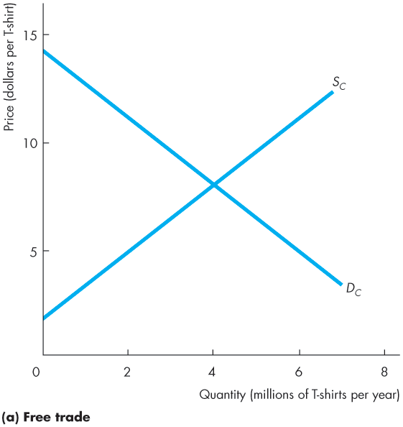
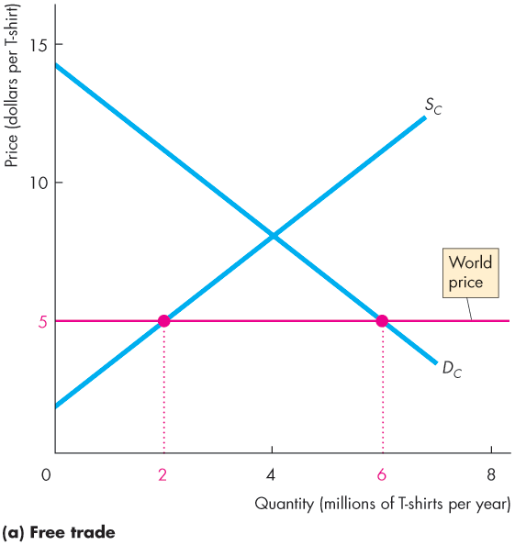
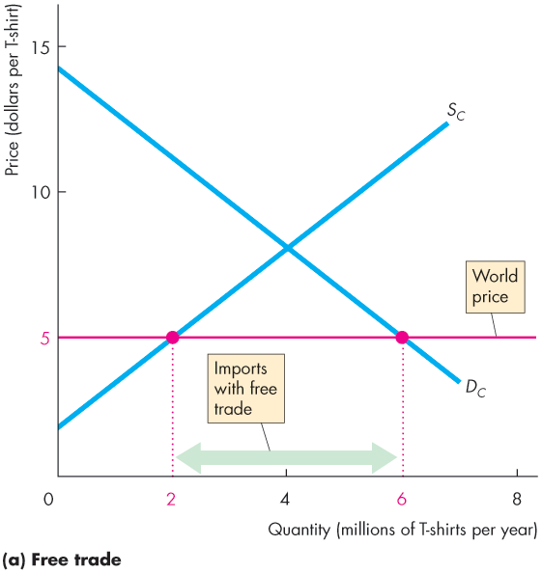
International Trade Restrictions
Figure 15.4(a) shows the market before the government imposes an import quota on T-shirts.
The world price is $5 and
Canada imports 4 million T-shirts a year.

Slide 37
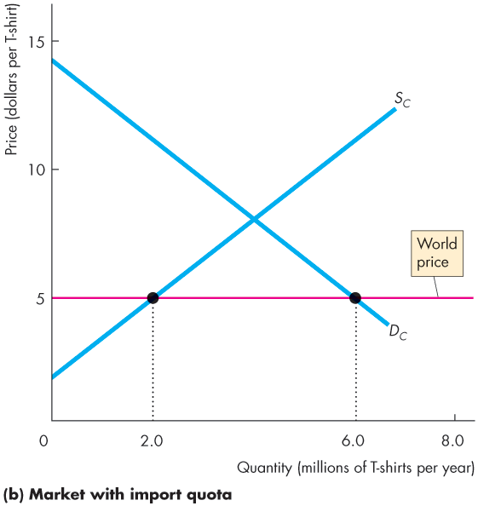
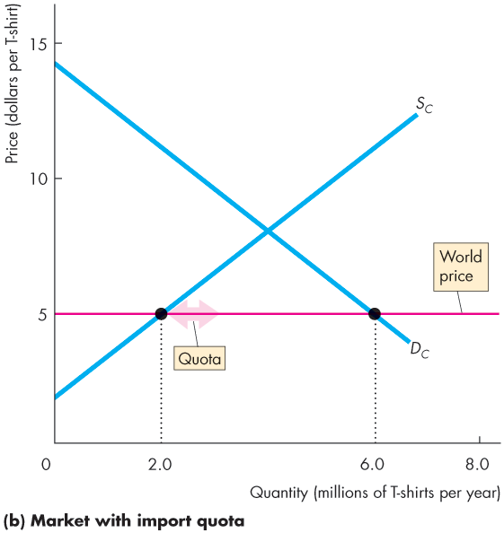
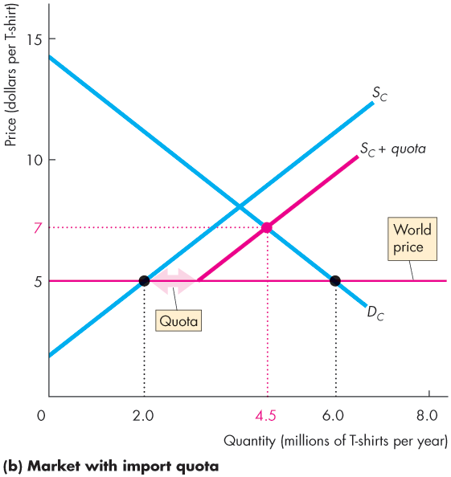
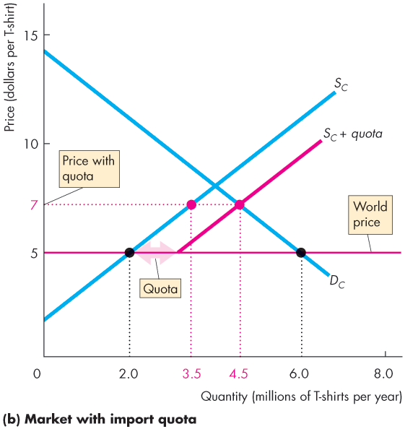
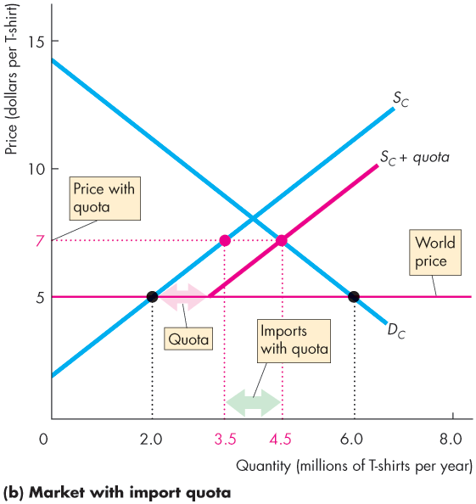
International Trade Restrictions
Figure 15.4(b) shows the market with an import quota of 1 million T-shirts.
With the quota, the supply of T-shirts in Canada becomes S_{C} + quota.
The price rises to $7.
The quantity produced in Canada increases and the quantity bought decreases.
Imports decrease.

Slide 39
International Trade Restrictions
Winners, Losers, and Social Loss from an Import Quota
When the U.S. government imposes an import quota on imported T-shirts:
Canadian consumers of T-shirts lose.
Canadian producers of T-shirts gain.
Importers of T-shirts gain.
Society loses.

Slide 40
International Trade Restrictions
Canadian Consumers of T-Shirts Lose
Canadian buyers of T-shirts now pay a higher price (the world price plus the tariff), so they buy fewer T-shirts.
The combination of the higher price and the smaller quantity bought makes Canadian consumers worse off.
So Canadian consumers lose when an import quota is imposed.

Slide 41
International Trade Restrictions
Canadian Producers of T-Shirts Gain
Canadian garment makers can now sell T-shirts for a higher price (the world price plus the tariff), so they produce more T-shirts.
The combination of the higher price and the larger quantity produced increases the profit of domestic producers
So Canadian producers gain when an import quota is imposed.

Slide 42
International Trade Restrictions
Importers of T-shirts Gain
The importer buys the T-shirts in the world market at the world price and sells them in the U.S. market at a higher price.
The import gains from the import quota.

Slide 43
International Trade Restrictions
Society Loses
Society loses because the loss to consumers exceeds the gain to domestic producers and importers.
Part of the social loss arises from the increase in the domestic producers’ cost of production.
There is also a social loss from the decreased quantity bought at the higher price.

Slide 44
International Trade Restrictions
Other Import Barriers
Thousands of detailed health, safety, and other regulations restrict international trade.
Export Subsidies
An export subsidy is a payment made by the government to a domestic producer of an exported good.
Export subsidies bring gains to domestic producers, but they result in overproduction in the domestic economy and underproduction in the rest of the world and so create a deadweight loss.
Notes:
Classroom activity
Check out Economics in Action: Self-Interest Beats the Social Interest

Slide 45
The Case Against Protection
Despite the fact that free trade promotes prosperity for all countries, trade is restricted.
Seven arguments for restricting international trade are that protecting domestic industries from foreign competition
Helps an infant industry grow.
Counteracts dumping.
Saves domestic jobs.
Allows us to compete with cheap foreign labour.
Penalizes lax environmental standards.
Prevents rich countries from exploiting developing countries.
Reduces offshore outsourcing that sends Canadian jobs abroad.
Notes:
Unrestricted international trade benefits all the countries involved with trade.
Emphasize the key benefits from unrestricted international trade:
The gains from international trade arise from the diversity of opportunity costs of production across countries. The source of prosperity in free trade arises from each country generating gains from specialization in their comparative advantage, minimizing its own opportunity cost of production, and sharing in each of the other country’s gains.
Both exporting and importing domestic industries benefit from free trade. Free trade liberates each country’s consumption possibilities from the bonds of their own production possibilities frontier, enabling the consumers in both the importing and exporting country to enjoy consumption bundles of goods and services that would be unobtainable without trade.
Restrictions on international trade hurt the importing firms, the consumers of imports, the domestic exporting firms, and even the non-exporting firms. Protecting domestic industry from international competition backfires: i) it increases the relative price that other countries pay for domestically produced goods and services that are exported; ii) it raises the price of the imported goods consumed by domestic consumers; and iii) it lowers the income of producers of the goods for which the country has a comparative advantage in production by more than the increase in the incomes of those industries that gain from trade restrictions. Together, these influences decrease the total demand for domestic goods and services in the country imposing trade restrictions by more than the increase in demand for those domestic goods and services in industries for which the country does not have a comparative advantage.

Slide 46
The Case Against Protection
Helps an Infant Industry to Grow
Comparative advantages change with on-the-job experience called learning-by-doing.
When a new industry or a new product is born—an infant industry—it is not as productive as it will become with experience.
It is argued that such an industry should be protected from international competition until it can stand alone and compete.
Learning-by-doing is a powerful engine of productivity growth, but this fact does not justify protection.

Slide 47
The Case Against Protection
Counteracts Dumping
Dumping occurs when a foreign firm sells its exports at a lower price than its cost of production.
This argument does not justify protection because
1. It is virtually impossible to determine a firm’s costs.
2. It is hard to think of a global monopoly, so even if all domestic firms are driven out, alternatives would still exist.
3. If the market is truly a global monopoly, it is better to regulate the monopoly rather than restrict trade.

Slide 48
The Case Against Protection
Saves Domestic Jobs
The idea that buying foreign goods costs domestic jobs is wrong.
Imports destroy some jobs but create jobs for retailers that sell the imported goods and for firms that service these goods.
Free trade also increases foreign incomes and enables foreigners to buy more domestic production.
Protection to save particular jobs is very costly.
Notes:
[Continuing the story of Adam Blackbox.]
The press becomes increasingly curious about what is going on in the giant New England auto plant. Investigative journalists create endless hours of speculative television programming on the amazing new technology. Then a tabloid journalist with a big checkbook finds a worker who is willing to talk. Adam Blackbox's secret is revealed. Nothing is produced at the plant. Adam Blackbox is a trader, not a producer. He buys grain from American farmers, exports it to Japan, and imports automobiles from Japan.
His secret revealed, Adam Blackbox is hauled before Congressional committees on fair trade and denounced as an evil destroyer of American jobs. The president makes a special State of the Union speech in which he denounces Adam Blackbox, praises a vigilant press for saving Americans from the threat of cheap foreign labour, and announces a new budget initiative that will spend $50 billion on research in technologies to produce low cost, high-quality automobiles.
The gains from trade are like a technological advance. Adam Blackbox expanded the nation’s consumption possibilities just like a technological advance might have done. But he didn’t expand production possibilities and save American jobs.
Use this fable to generate a classroom discussion of questions such as:
Why did the president and Congress accept Adam Blackbox when they thought he had expanded production possibilities but not when they discovered that he had “only” expanded consumption possibilities?

Slide 49
The Case Against Protection
Allows Us to Compete with Cheap Foreign Labour
The idea that a high-wage country cannot compete with a low-wage country is wrong.
Low-wage labour is less productive than high-wage labour.
And wages and productivity tell us nothing about the source of gains from trade, which is comparative advantage.

Slide 50
The Case Against Protection
Penalizes Lax Environmental Standards
The idea that protection is good for the environment is wrong.
Free trade increases incomes and poor countries have lower environmental standards than rich countries.
These countries cannot afford to spend as much on the environment as a rich country can and sometimes they have a comparative advantage at doing “dirty” work, which helps the global environment achieve higher environmental standards.

Slide 51
The Case Against Protection
Prevents Rich Countries from Exploiting Developing Countries
By trading with people in poor countries, we increase the demand for the goods that these countries produce and increase the demand for their labour.
The increase in the demand for labour raises their wage rate.
Trade can expand the opportunities and increase the incomes of people in poor countries.
Notes:
Does free trade exploit workers in developing countries? Students might be somewhat familiar with the terminology of “exploitation”. Have the students think about what “exploitation” means in the context of voluntary trade. If I benefit from someone I trade with, did I exploit them? Did they exploit me? If trade is voluntary, how did I manage to exploit the person whom I traded with? Is it because I am smarter than the other person? This seems to be the condescending assumption of those who talk about exploitation of workers in developing countries. Indeed, representatives from many developing countries do not see trade as exploitation, but rather see it as a way to improve standards of living. When these representatives are upset at WTO meetings, it is usually about the trade restrictions rich countries place on imports from developing countries keeping developing countries poor.

Slide 52
The Case Against Protection
Reduces Offshore Outsourcing that Sends Canadian Jobs Abroad
Offshore outsourcing occurs when a firm in Canada buys finished goods, components, or services from firms in other countries.
Despite the gain from specialization and trade that offshore outsourcing brings, many people believe that it also brings costs that eat up the gains. Why?
Canadians, on average, gain from offshore outsourcing, but some people lose.
The losers are those who have invested in the human capital to do a specific job that has now gone offshore.
Notes:
Classroom activity
Check out At Issue: Is Offshore Outsourcing Bad or Good for Canada?

Slide 53
The Case Against Protection
Why Is International Trade Restricted?
The key reason why international trade restrictions are popular in Canada and most other developed countries is an activity called rent seeking.
Rent seeking is lobbying and other political activity that seeks to capture the gains from trade.
You’ve seen that free trade benefits consumers but firms that compete in markets with imports lose.

Slide 54
The Case Against Protection
Those who gain from free trade are the millions of consumers of low-cost imports.
But the benefit per individual consumer is small.
Those who lose are the producers of import-competing items.
Compared to the millions of consumers, there are only a few thousand producers.
These producers have a strong incentive to incur the expense of lobbying for a tariff and against free trade.

Slide 55
The Case Against Protection
The gain from free trade for any one person is too small for that person to spend much time or money on a political organization to lobby for free trade.
Each group weighs benefits against costs and chooses the best action for themselves.
But the group against free trade will undertake more political lobbying than will the group for free trade.

